Slide 1
Understanding the positive trend in total water storage of the Ob basin using spaceborn observation
Ziqing Yu
Supervisor:
Dr.-Ing. Mohammad Tourian
M.Sc. Peyman Saemian
November. 11, Stuttgart

Slide 2
Outline
Introduction
Motivation
Study Area
Data
Method
Results
Conclusion and Outlook

Slide 3
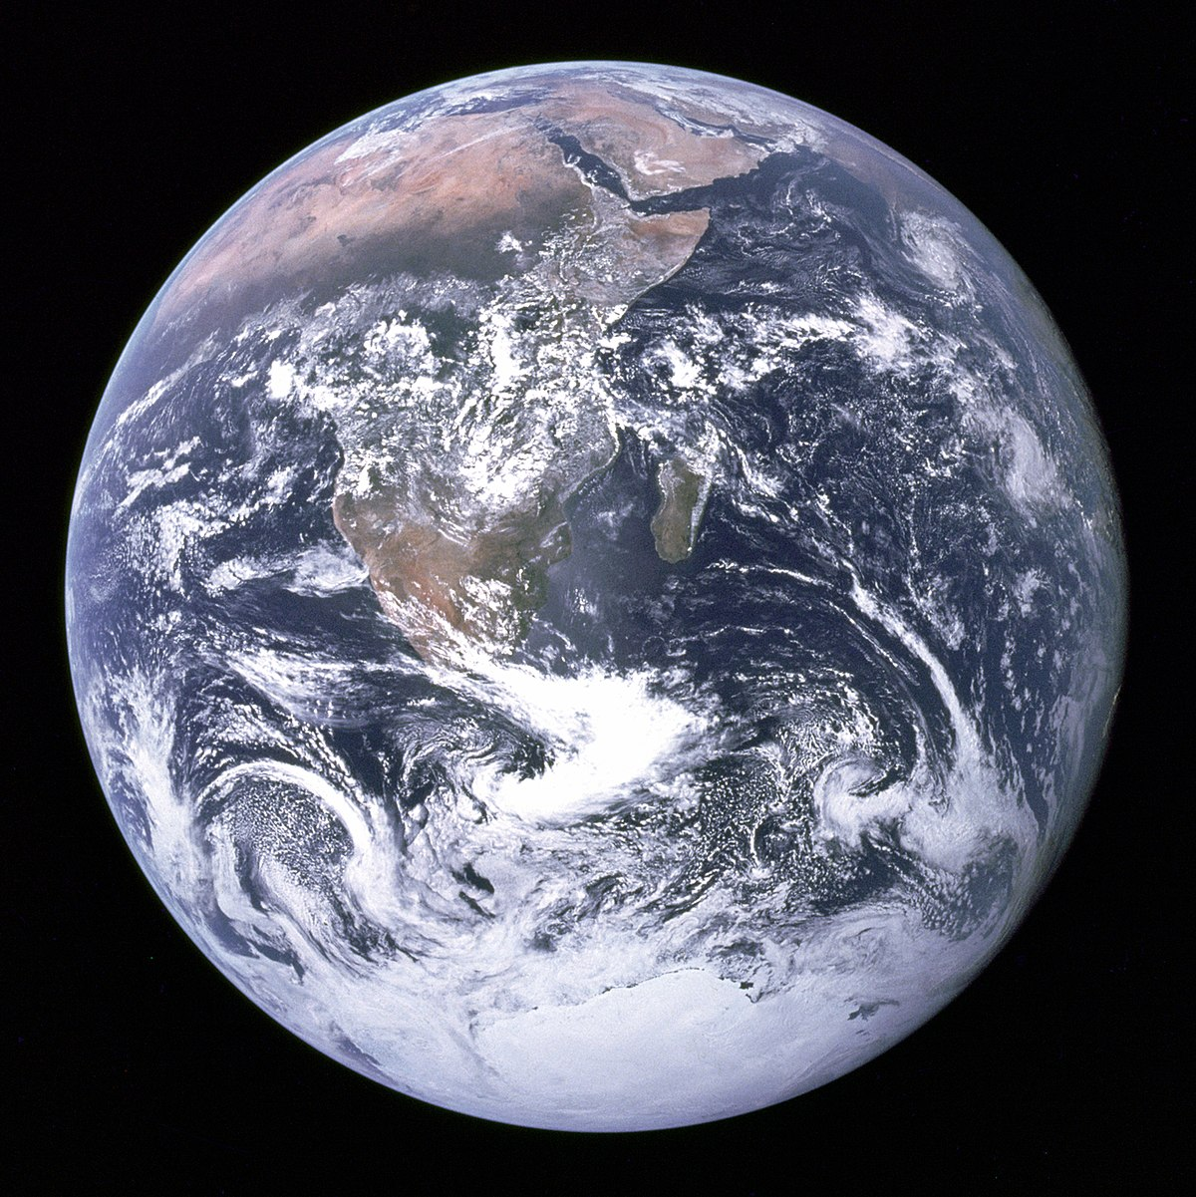
Introduction
71% of surface
98% in the oceans
1.6% in ice caps
0.4% is fresh on land
https://en.wikipedia.org/wiki/Earth

Slide 4
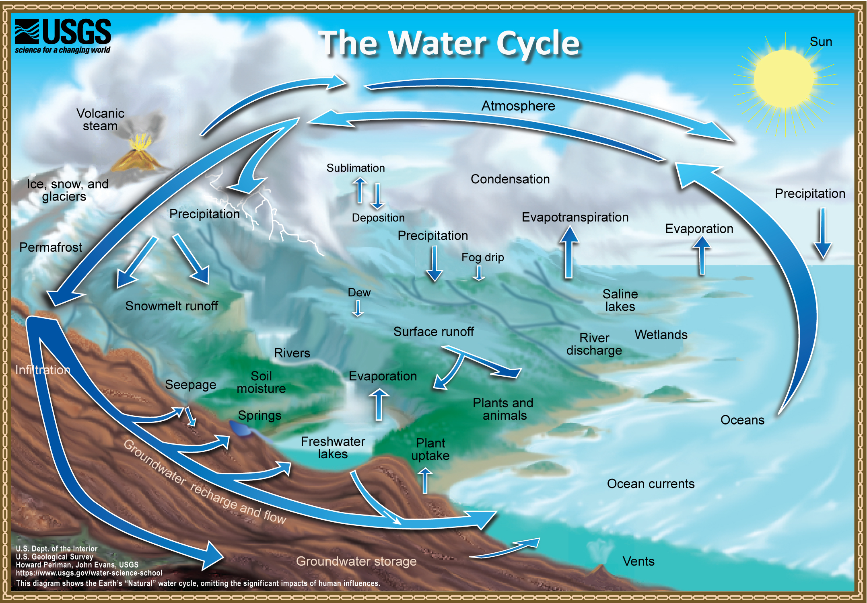
Introduction
Total water storage
Hydrological Cycle
Precipitation
Evapotranspiration
Runoff
https://www.usgs.gov/special-topic/water-science-school/
science/water-cycle-adults-and-advanced-students

Slide 5
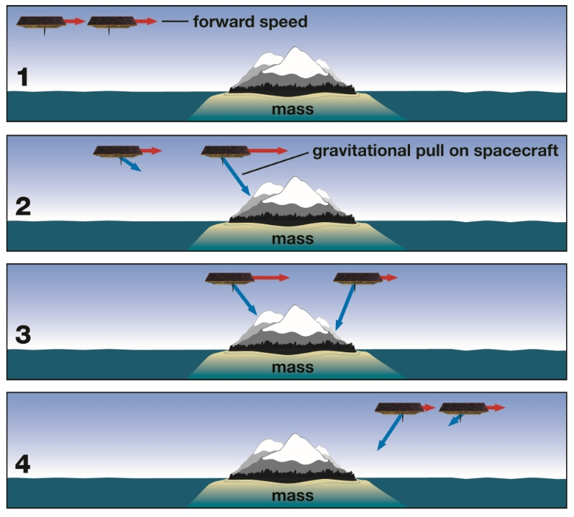
Introduction
GRACE and GRACE-FO
GRACE
Mar 2002 to Oct 2017
GRACE-FO
Since May 2018
https://gracefo.jpl.nasa.gov/resources/50/how-grace-fo-measures-gravity/

Slide 6
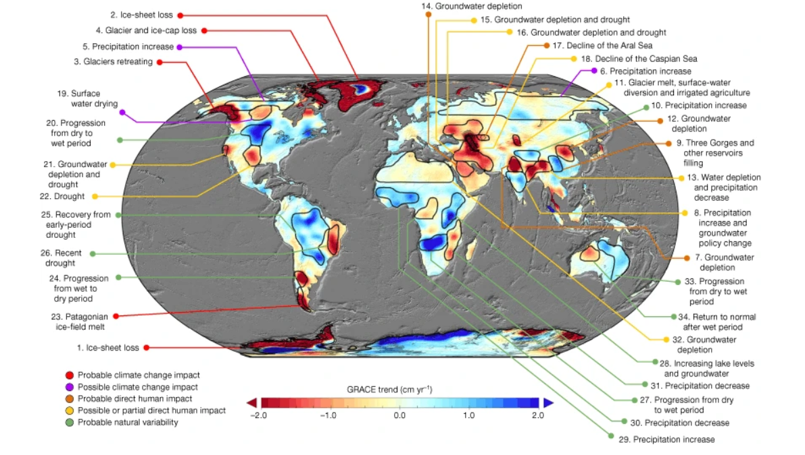
Motivation
Global Water Change
Matthew Rodell, JS Famiglietti, DN Wiese, JT Reager, HK Beaudoing, Felix W Landerer,
and M-H Lo. Emerging trends in global freshwater availability . Nature, 557(7707):651–659,
2018.

Slide 7
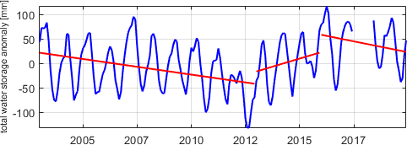
Motivation
Total water storage change from Jan. 2003 to Dec. 2019 in Ob river basin using mascon CSR RL06
Data are downloaded from:
http://www2.csr.utexas.edu/grace/RL06_mascons.html

Slide 8
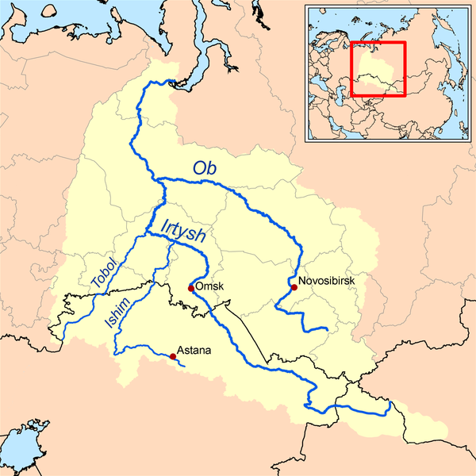
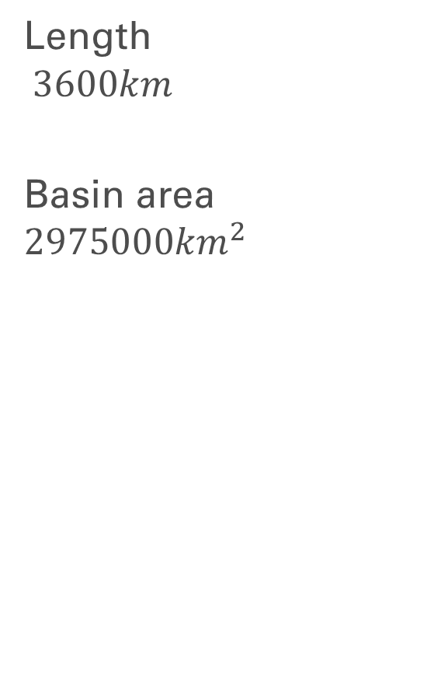
Study Area: Ob River Basin
http://www.geologypage.com/2014/03/ob-river.html

Slide 9
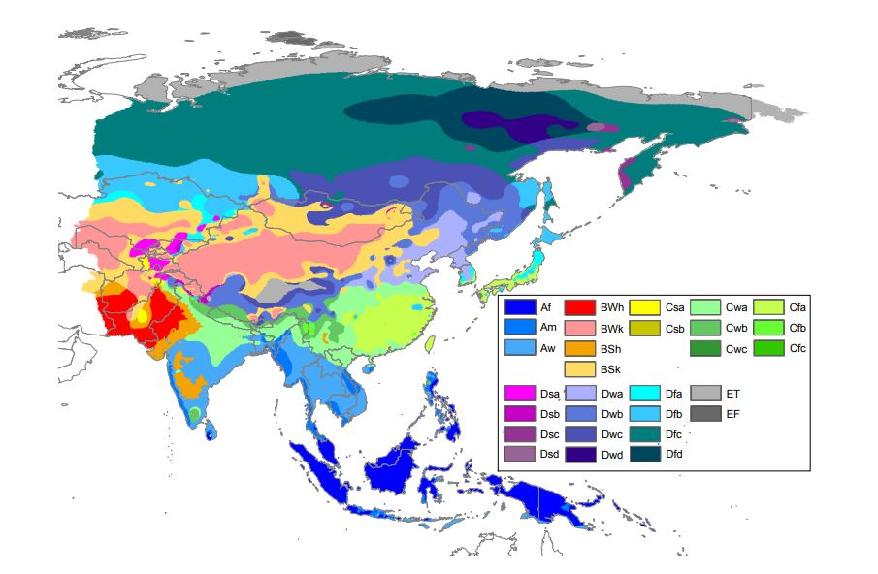
Study Area: Ob River Basin
M. C. Peel, B. L. Finlayson, and T. A. McMahon. Updated world map of the köppen-geiger climate classification. Hydrology and Earth System Sciences, 11(5):1633–1644, oct 2007.

Slide 10
Data
GRACE and GRACE-FO
Jet Propulsion Laboratory (JPL)
Center for Space Research (CSR)
German Research Centre for Geosciences (GFZ)
Institute of Theoretical Geodesy and Satellite Geodesy (ITSG)
The level-2 data can be downloaded from
http://icgem.gfz-potsdam.de/home

Slide 11
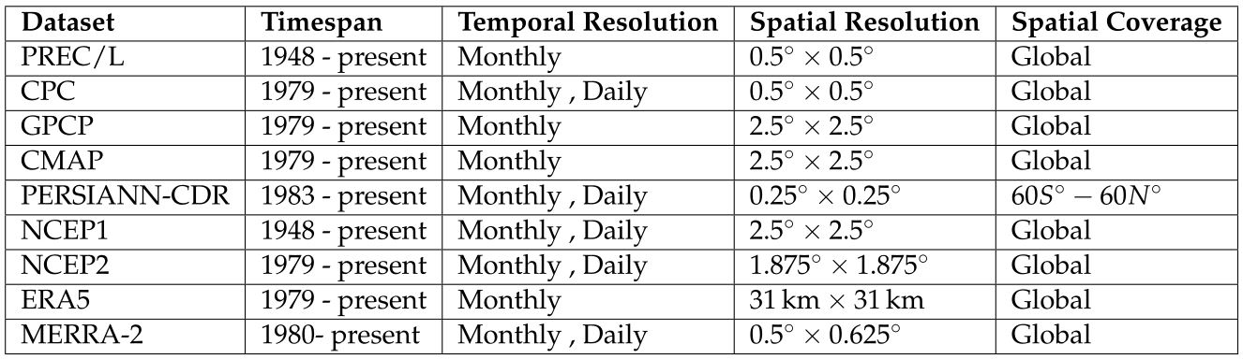
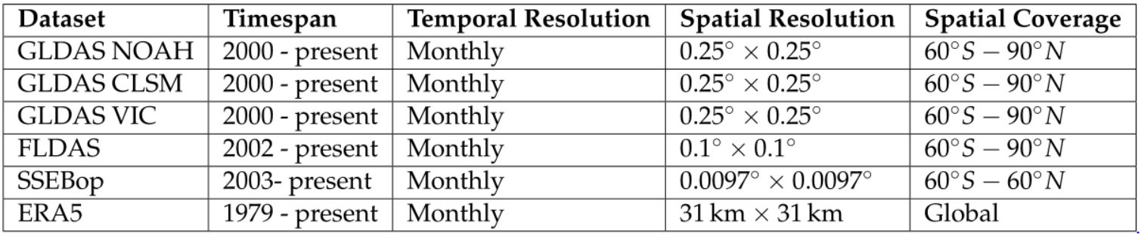
Data
Precipitation
Evapotranspiration

Slide 12
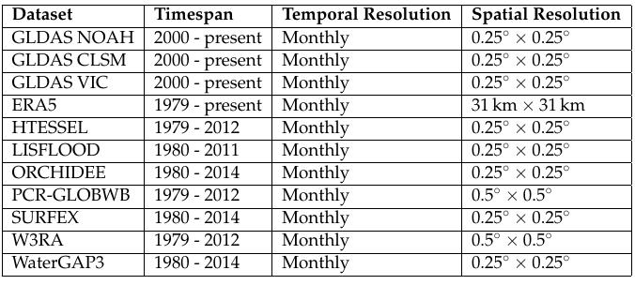
Data
Runoff
In-situ: GRDC
From 1954 to 2010

Slide 13
Data
Runoff Datasets Quality
Data Centre | RMSE (mm/month)
ERA5 | 8.18
HTESSEL | 10.40
LISFLOOD | 11.92
ORCHIDEE | 10.24
PCRGLOBWB | 9.48
GLDAS CLSM | 13.68
GLDAS NOAH | 17.01
GLDAS VIC | 25.95
SURFEX-TRIP | 22.05
W3RA | 16.47
WaterGAP3 | 11.03

Slide 14
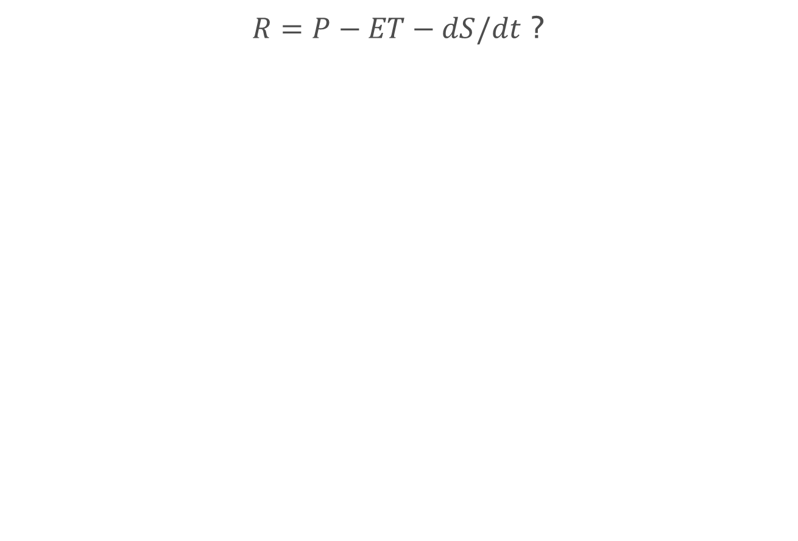
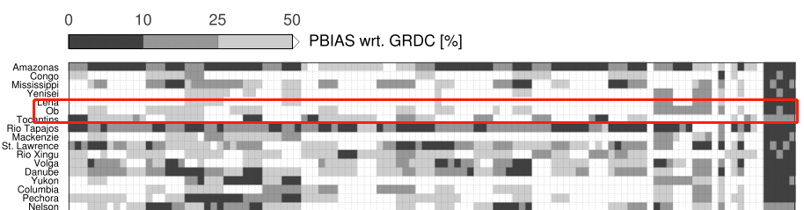
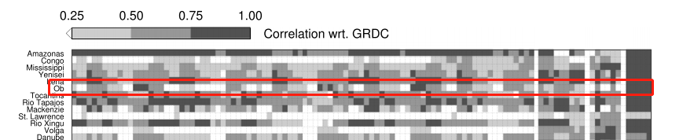
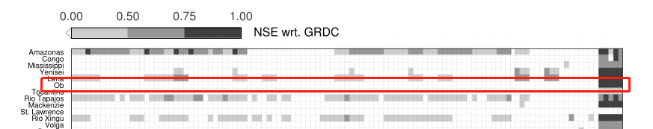
Data
Choose of different datasets
Christof Lorenz, Harald Kunstmann, Balaji Devaraju, Mohammad J Tourian, Nico Sneeuw, and Johannes Riegger. Large-scale runoff from landmasses: a global assessment XIV Bibliography of the closure of the hydrological and atmospheric water balances. Journal of Hydrometeorology, 15(6):2111–2139, 2014.

Slide 15
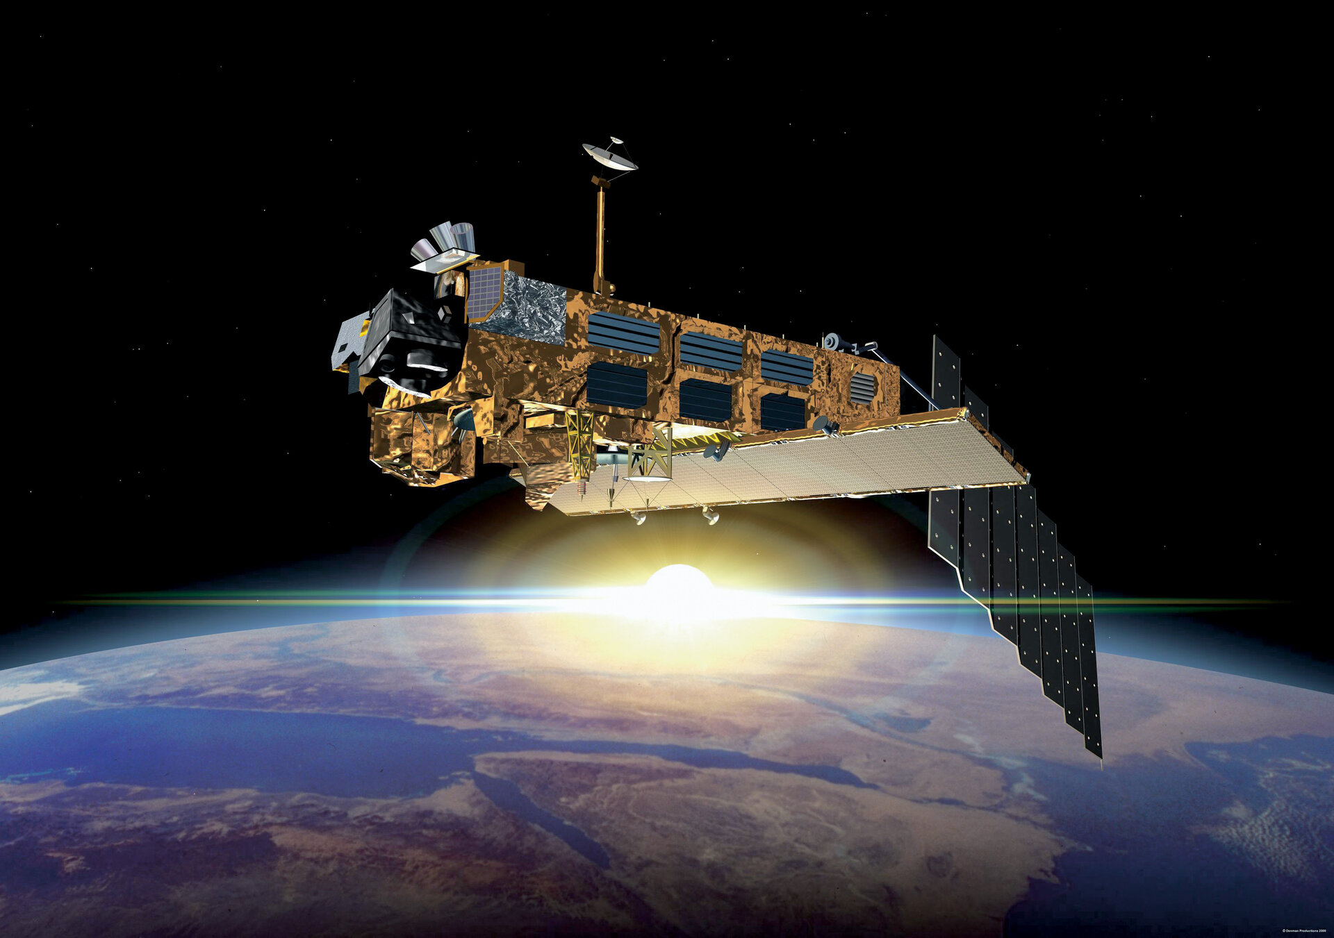
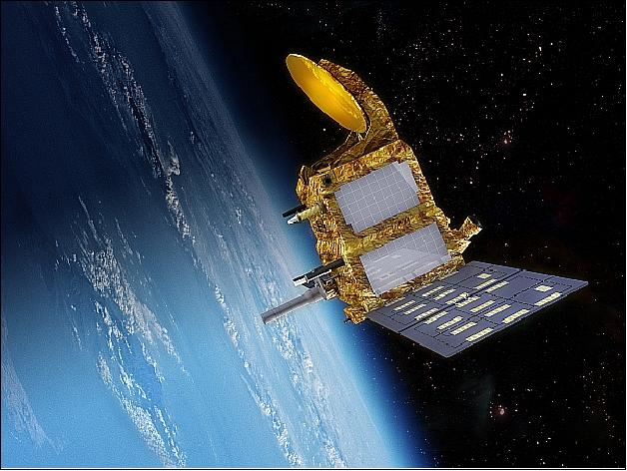
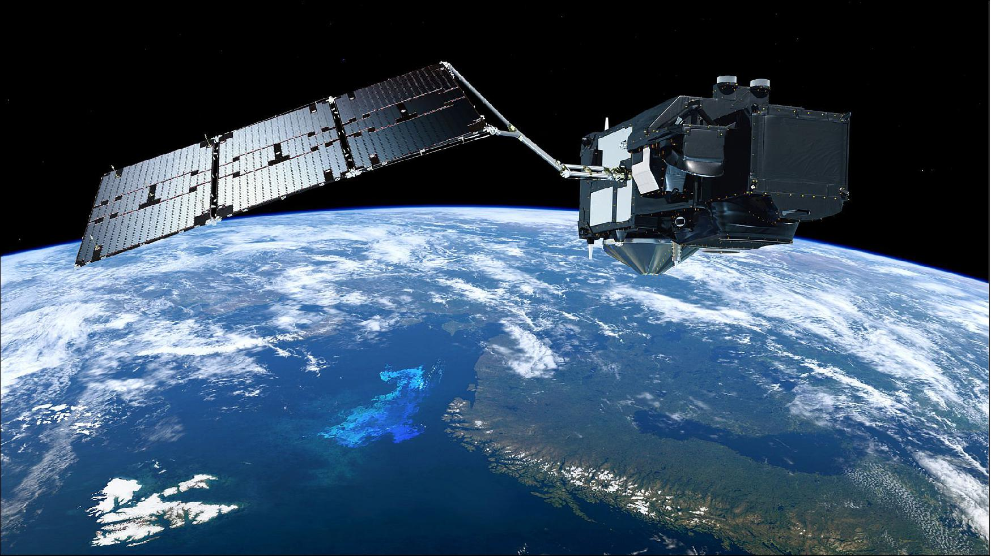
Data
Satellite Altimetry
Envisat
June of 2002 to October of 2010
https://www.esa.int/Applications/Observing_the_Earth/Envisat/ESA_declares_end_of_mission_for_Envisat
SARAL
February of 2013 to March of 2016
https://earth.esa.int/web/eoportal/satellite-missions/s/saral
Sentinel-3
Since February of 2016
https://directory.eoportal.org/web/eoportal/satellite-missions/c-missions/copernicus-sentinel-3

Slide 16
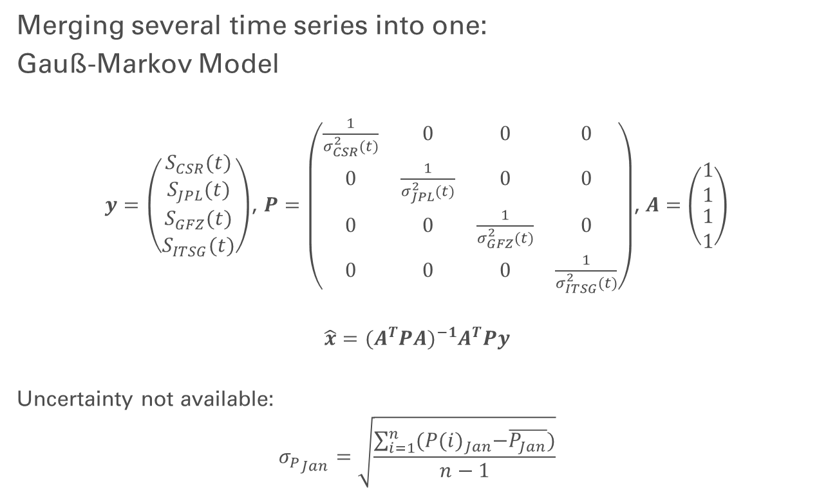
Methods

Slide 17
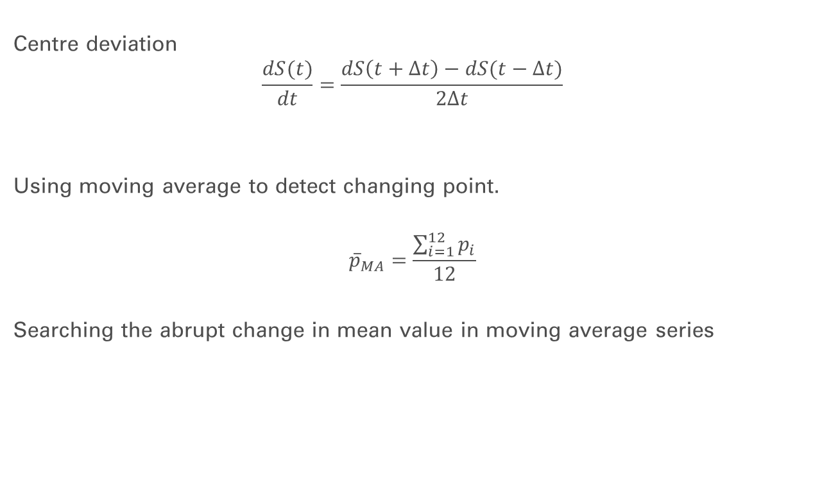
Methods
movmean
ischange

Slide 18
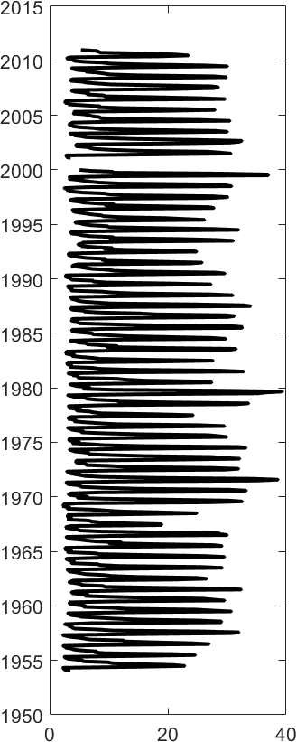
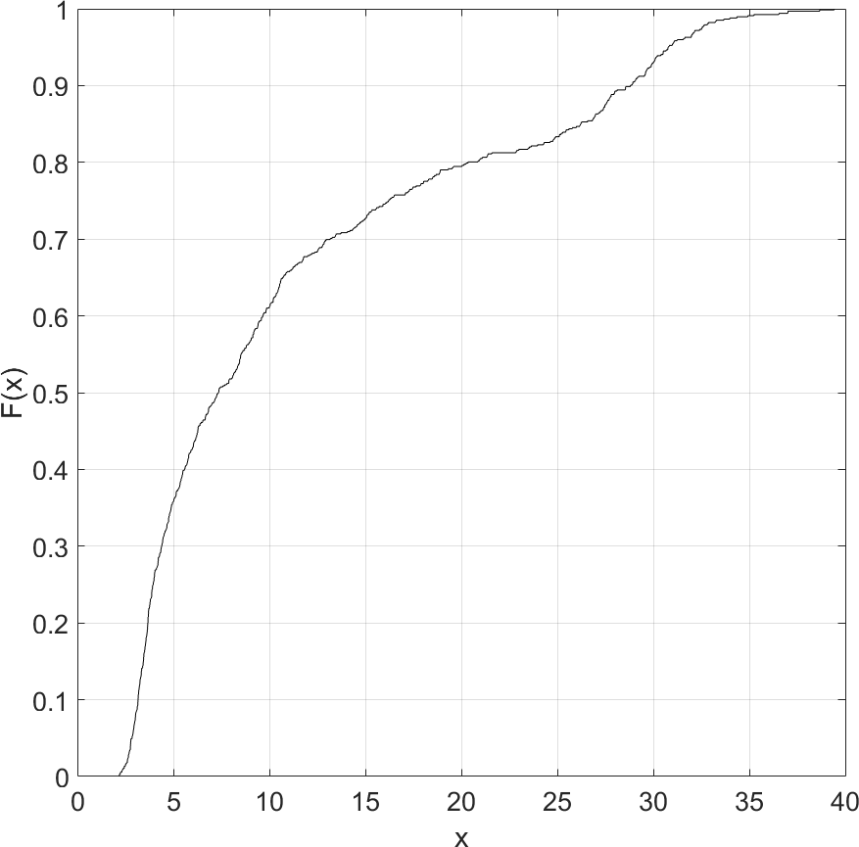
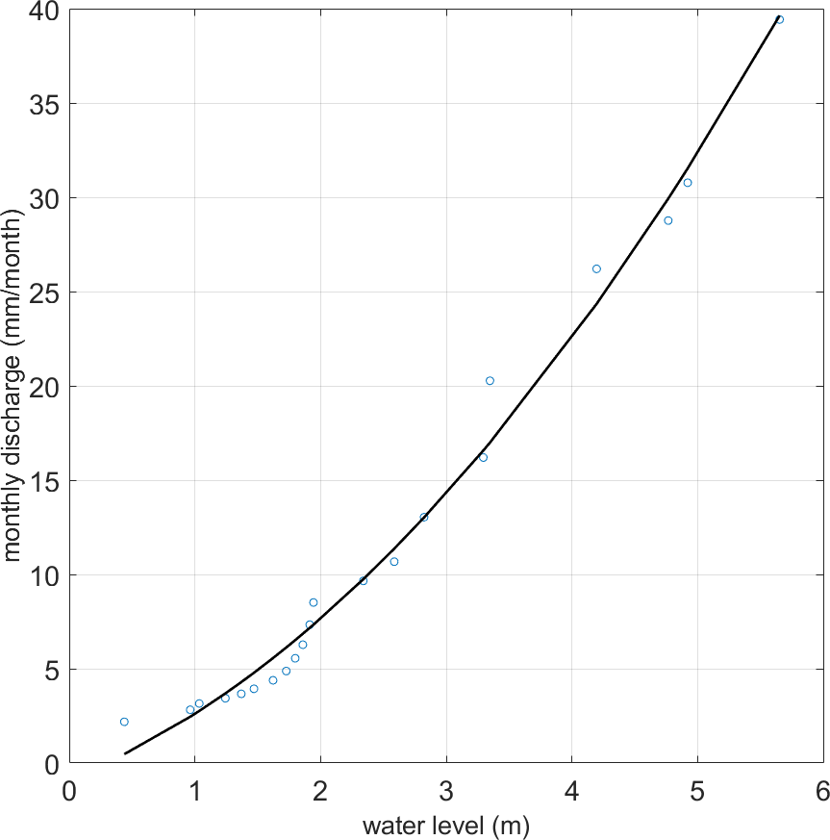
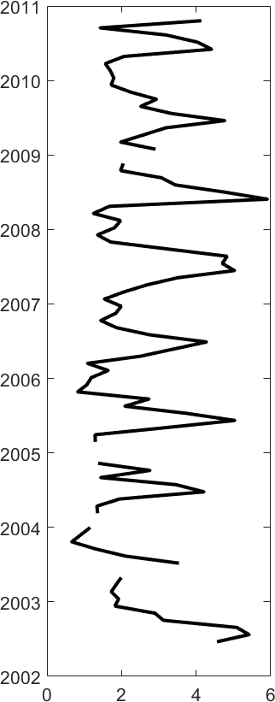
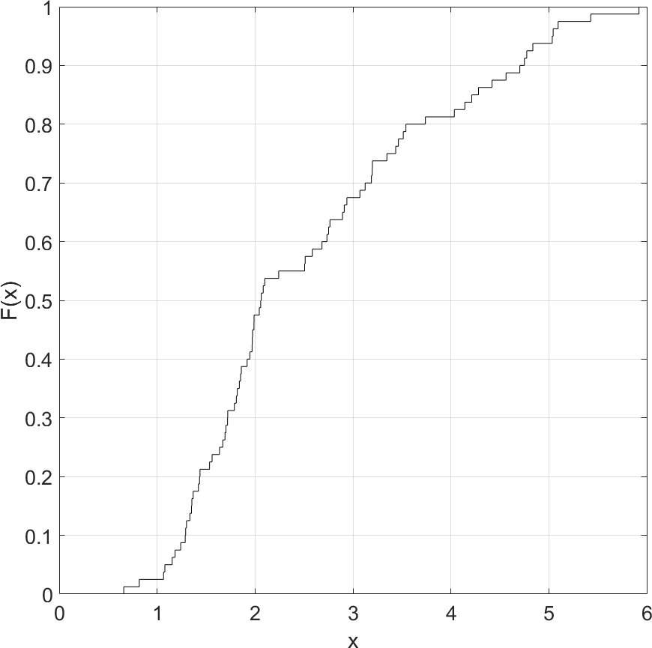
Methods
Method provided by
M. J. Tourian, N. Sneeuw, and A. Bárdossy . A quantile function approach to discharge
estimation from satellite altimetry (ENVISAT). Water Resources Research, 49(7):4174–4186,
jul 2013.
Runoff time series
Water level time series

Slide 19
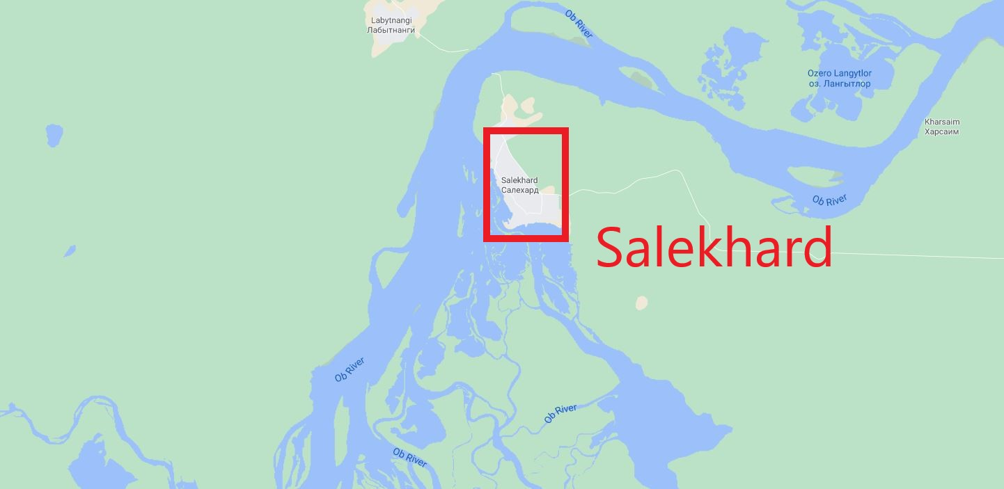
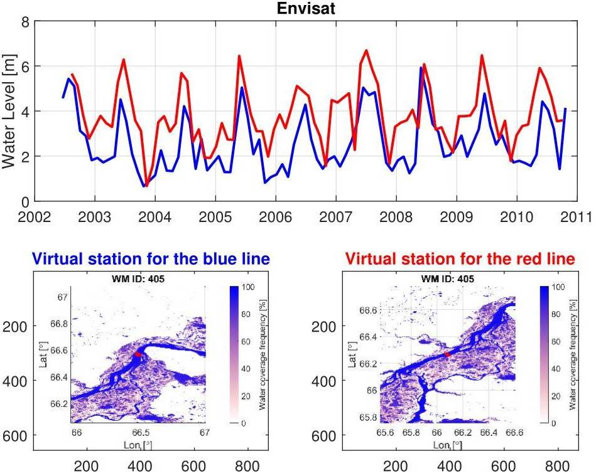
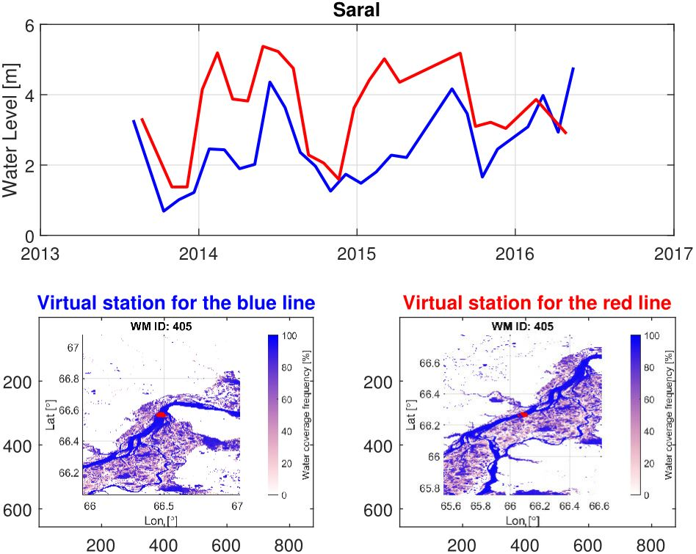
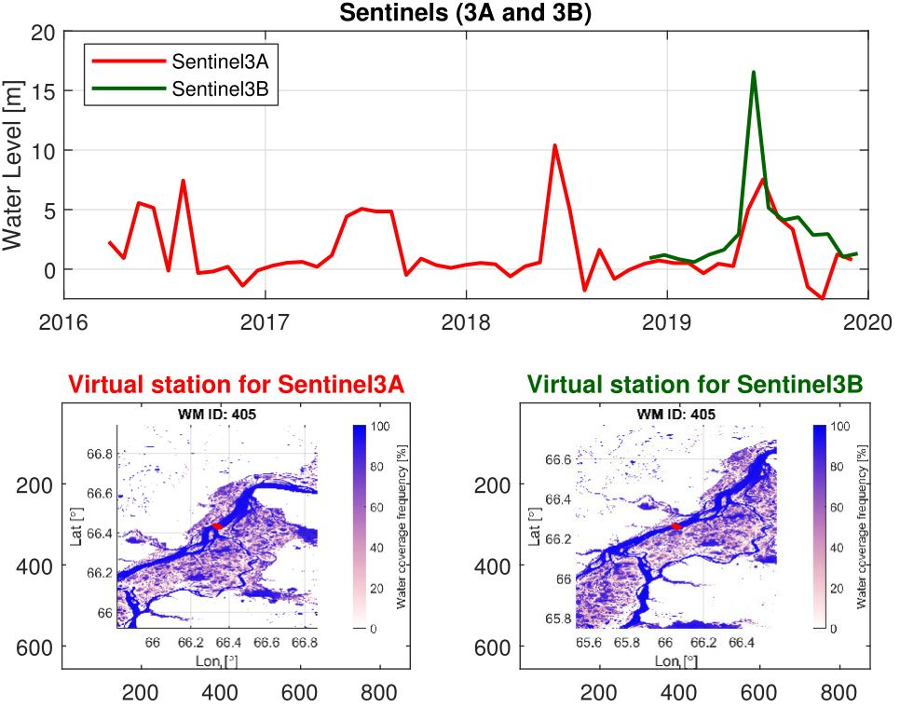
Methods
Virtual Station Chosen:
Near Salekhard
Envisat
SARAL
Sentinel

Slide 20
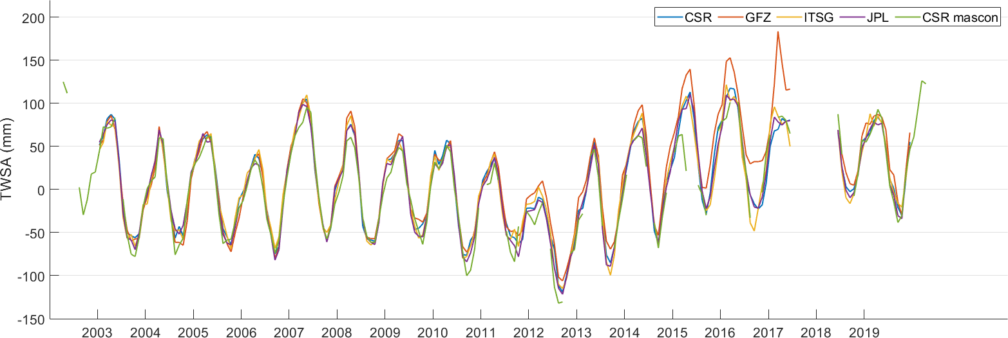
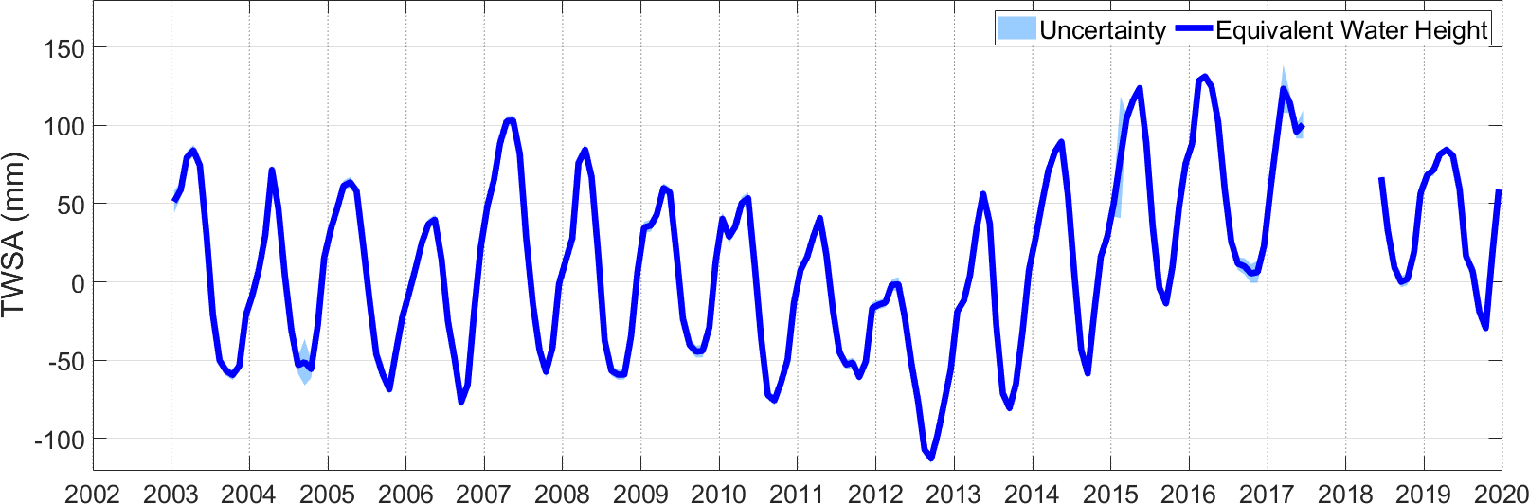
Results

Slide 21
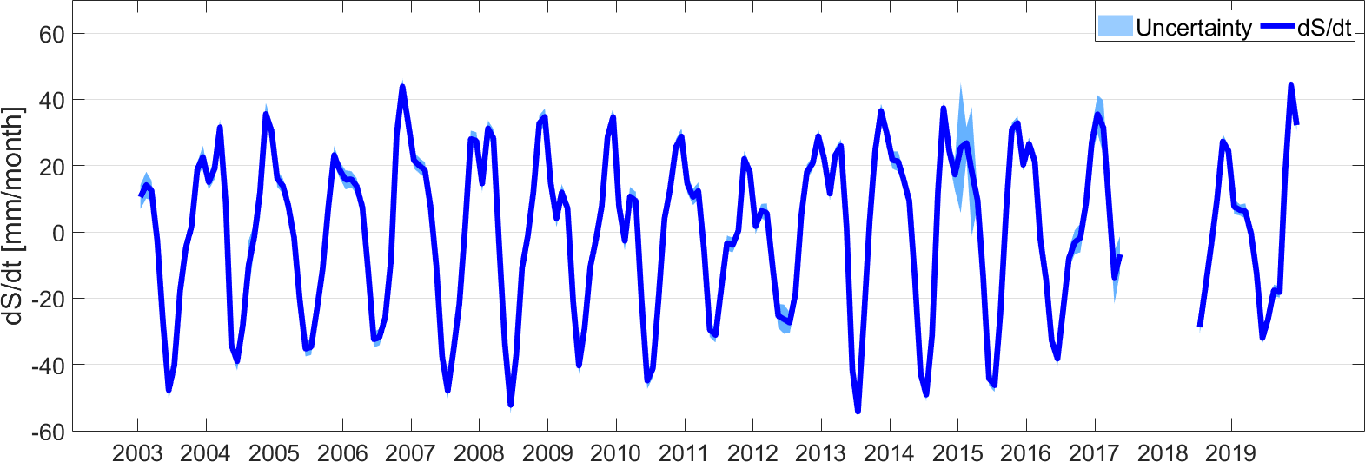
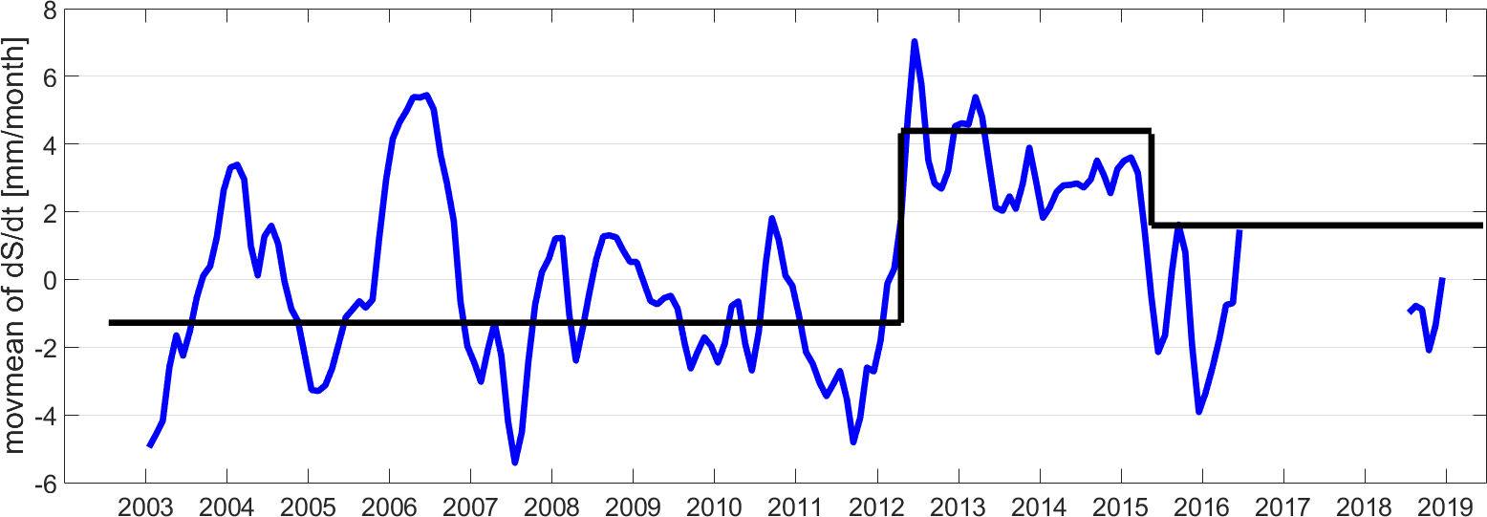
Results

Slide 22
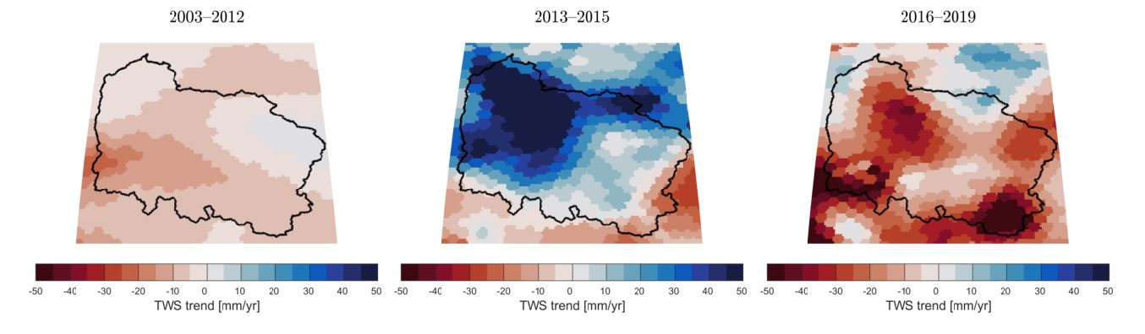
Results
Spatial TWS change of Ob river basin in each
period using mascon CSR RL06 solution

Slide 23
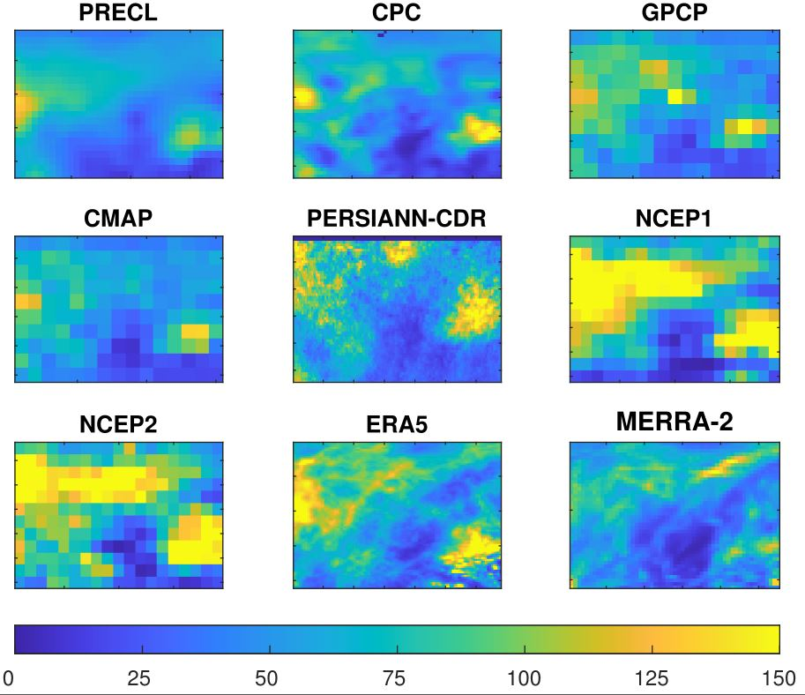
Results
spatial change of precipitation in Ob river basin using different datasets in June of 2003

Slide 24
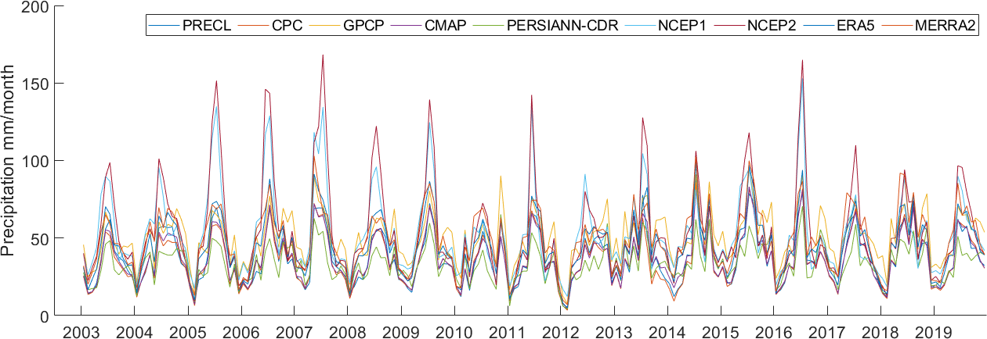
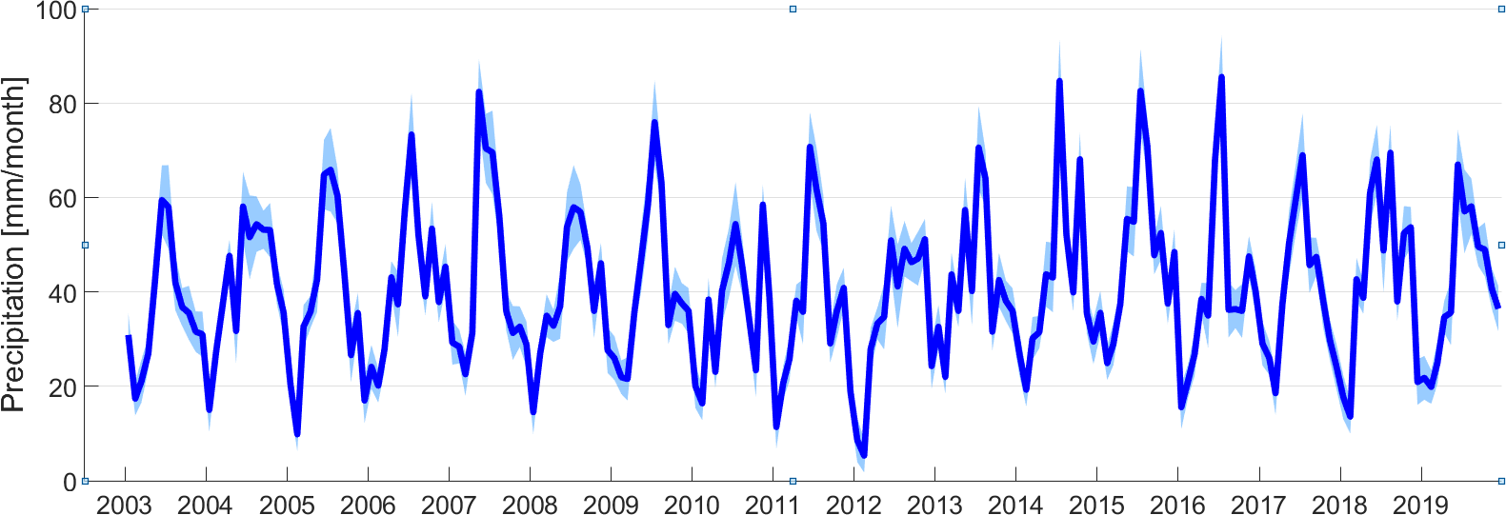
Results
Precipitation

Slide 25
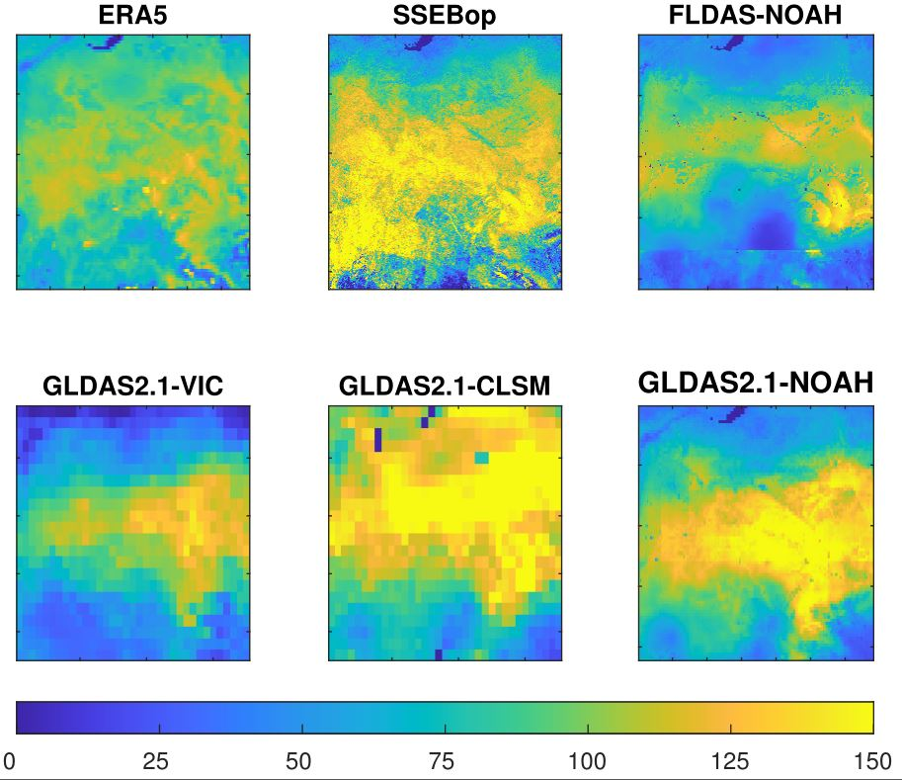
Results
spatial change of evapotranspiration in Ob river basin using different datasets in June of 2003

Slide 26
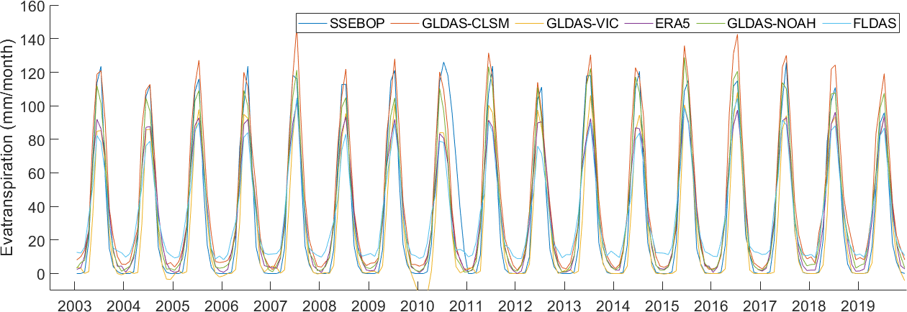
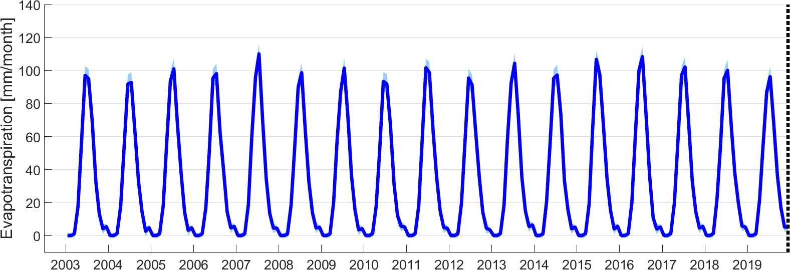
Results
Evapotranspiration

Slide 27
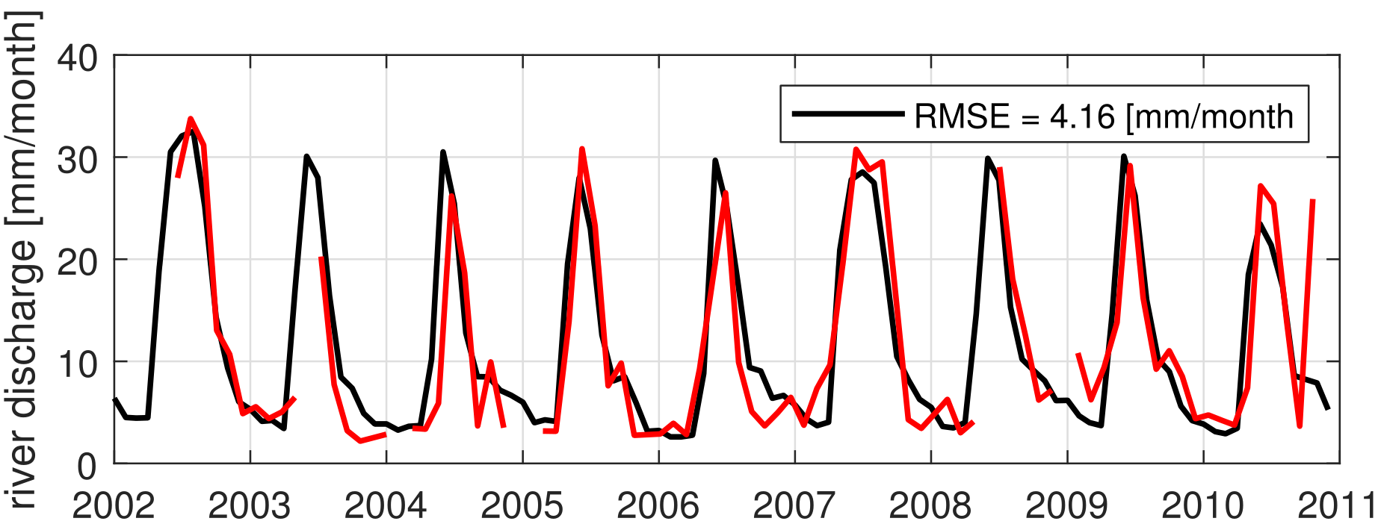
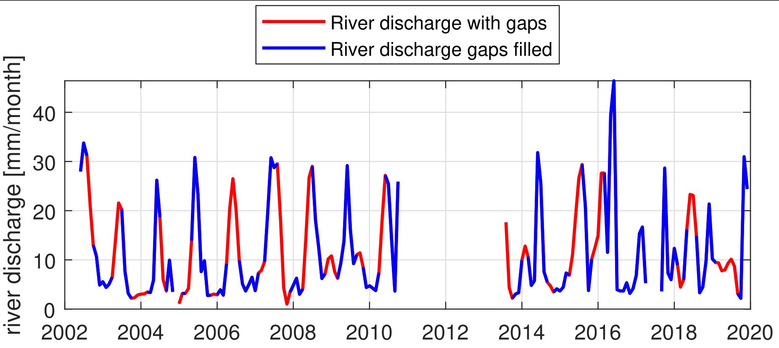
Results
Runoff
Runoff estimated from Envisat, SARAL and Sentinel

Slide 28
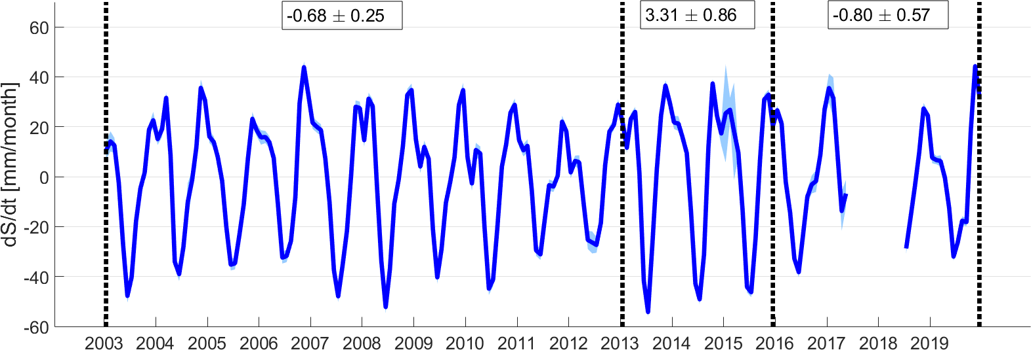
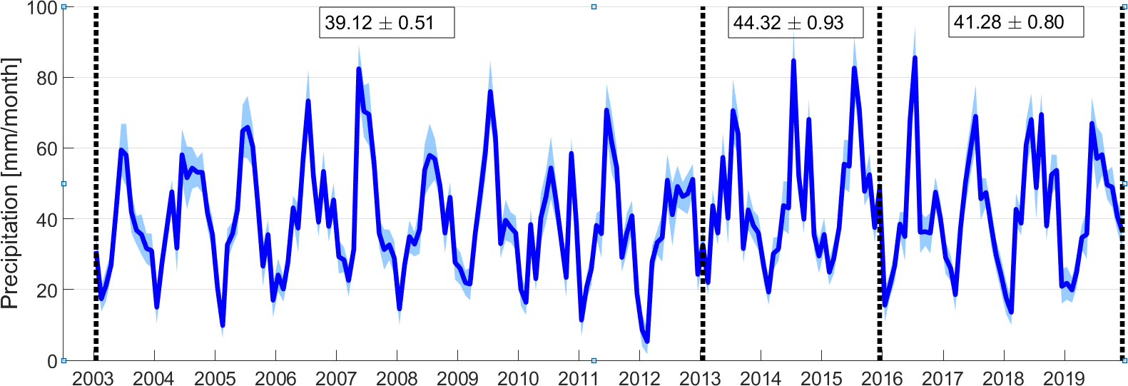
Results

Slide 29
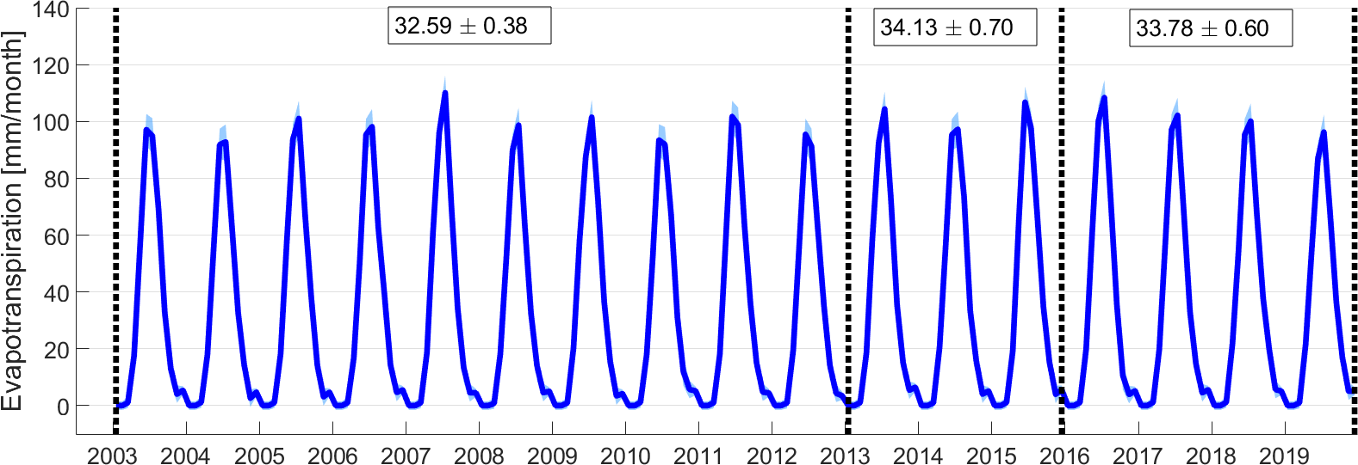
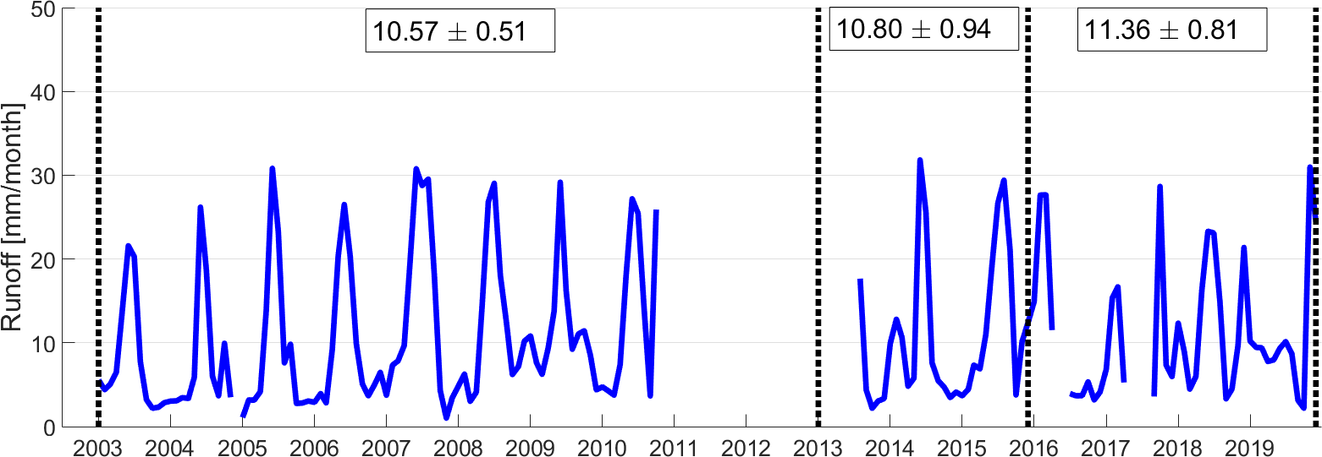
Results

Slide 30
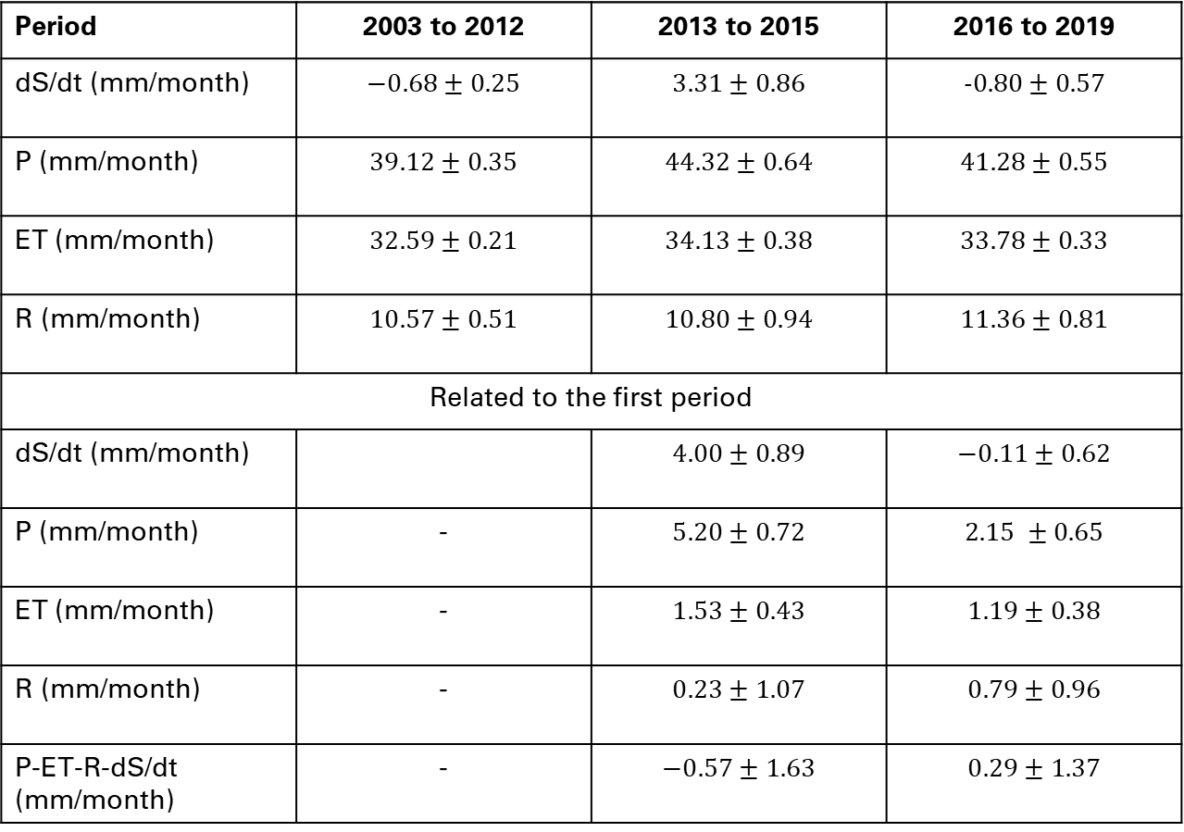
Result
Period | 2003 to 2012 | 2013 to 2015 | 2016 to 2019
dS/dt (mm/month)
P (mm/month)
ET (mm/month)
R (mm/month)
Related to the first period
dS/dt (mm/month)
P (mm/month) | -
ET (mm/month) | -
R (mm/month) | -
P-ET-R-dS/dt (mm/month) | -

Slide 31
Conclusion
Tendency
2003 to 2012
2013 to 2015
most increased precipitation remains in the area
2016 to 2019
stronger evapotranspiration and runoff
Outlook
Spatial analyze
Groundwater recharge & permafrost

Slide 32
Thank you very much!

